Slide 1

Group 12
Shenmin Lo, EE
Joseph Lunder, CpE
Siarhei Traskouski, EE
Robert Wadsworth II, EE

Slide 2
Motivation
To allow players separated across great distances to play Chess together
To streamline the process of practicing Chess against an AI
To create an elegant physical and virtual environment that is easy to use
To put a spin on traditional gameplay and create a new way to play a classic game

Slide 3
Deep RGB?
Automated Chess Board
  Use magnets to move pieces
  Take input physically from user
  Correct user errors
  Visually assists gameplay
  Multiple playing modes
  Sends data wirelessly to off-site server
Web Interface
  Allow gameplay from any web-enabled device
  Allow for environment customization
  Store saved games and other user data

Slide 4
Goals
Allow for play between human and computer, human and remote human, or two computers
Connect to server over any available wireless network
Detect pieces using a Hall-Effect sensor grid
Make required moves with under-board magnet
Show available moves via in-board LEDs
Play selected sound effects depending on game state

Slide 5
Requirements
Weight of entire unit no more than 10kg
Dimensions of playing field no larger than 40cm by 40cm
Dimensions of whole unit no larger than 70cm by 55cm by 20 cm
Operates under 110-220V 50/60Hz AC
Pieces positioned with less than 10% error

Slide 6
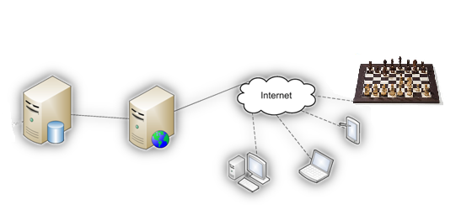
Subsystem Layout

Slide 7
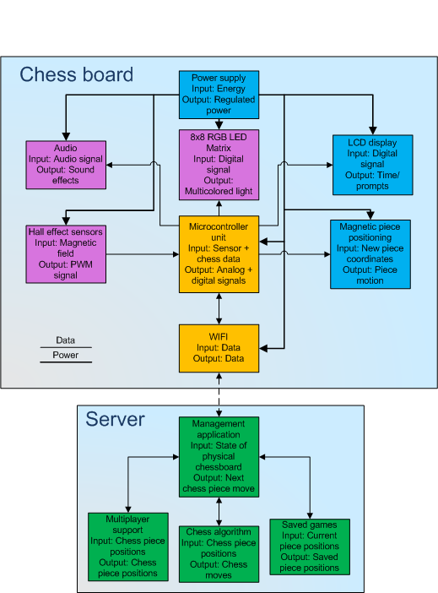
Full System
Labor is divided into hardware and software
Hardware subsystems
  Shenmin in yellow
  Robert in pink
  Siarhei in blue
Software subsystems
  Joseph in green

Slide 8
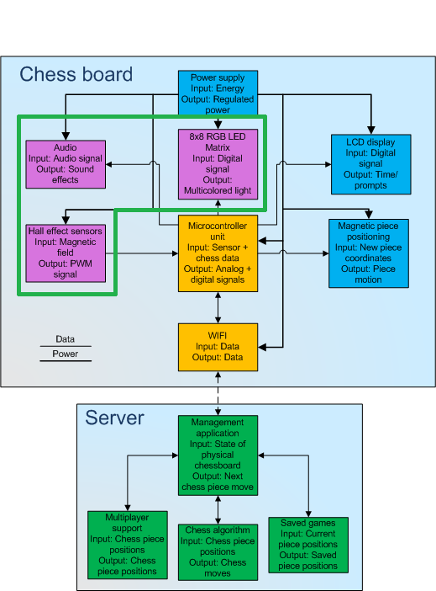

Slide 9
RGB Light Emitting Diodes
 | RL5-RGB-C-2 | R596CR3G4B5C-C10 | R596CR3G4B5W-F12
Operating Voltage (R,G,B) | 2.4, 3.5, 3.5 V | 2.2, 3.4, 3.4 V | 2.2,3.4,3.4 V
I(Peak) | 50mA | 30mA | 30mA
Viewing Angle | 60° | 40° | 40°
Luminosity | 1K-5K mcd | 800-4000 mcd | 1200-6500 mcd
Diameter | 5mm | 5mm | 5mm
Package | SIP | SIP | SIP
Pins | 4 | 4 | 4
Price per Unit | $0.79 | $0.60 | $0.60

Slide 10
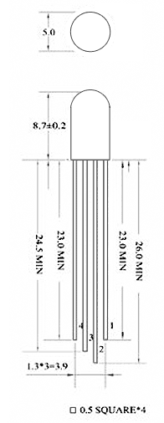
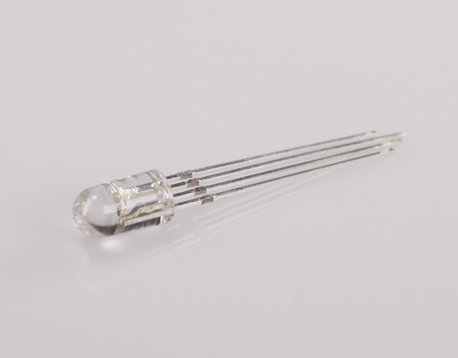
RL5-RGB-C-2
Substituted for the R596CR3G4B5W-F12
Super bright RGB LED
Highest Viewing angle
Capable of creating a wide array of colors
Compact design
Low cost

Slide 11
LED Array Functionality
Display available moves when a piece is picked up
Visual queues for errors
Helps distinguish between player’s pieces
Personalization and user customization

Slide 12
LED Array Implementation
Each pin is connected to a specific rail running horizontally and vertically
Each LED is activated one at a time by activating two or more rails
Rails are controlled using four shift registers connected in series
Each register controls one group of rails; red, green, blue and cathode
Implementation caused massive traffic on SPI bus

Slide 13
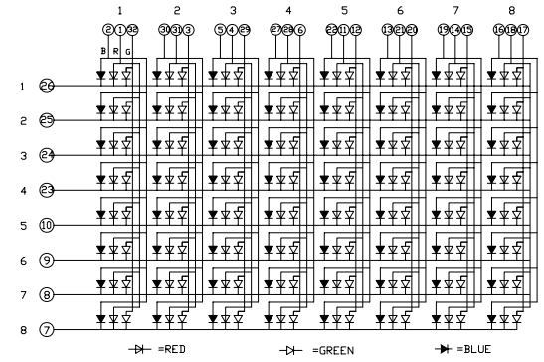
LED Array Schematic

Slide 14
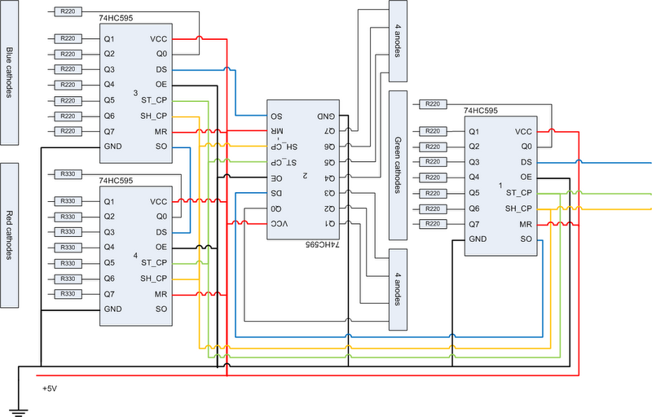
Shift Register Configuration

Slide 15
Hall-Effect Sensor
 | MLX 90215 | A1325 | A1302
VCC(recommended) | 5V | 5V | 4.5 – 6V
VCC(max) | 5.5V | 5.5V | 8V
I(max) | 6.5mA | 9mA | 11mA
Package | SIP | SIP | SIP
Pins | 4 | 3 | 3
Sensitivity | 5-140 mV/G | 3.125 mV/G | 0.85 – 1.75 mV/G
Price per Unit | $2.38 | $1.35 | $1.54

Slide 16
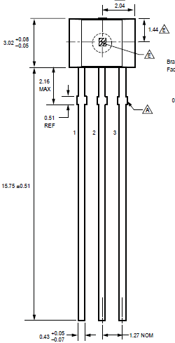
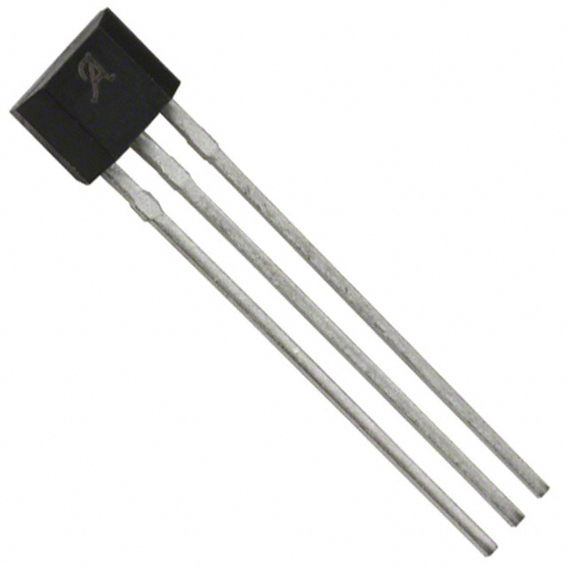
Allegro A1325
Linear ratiometric Hall-effect sensor
Capable of determining range and polarity
Simple, small and reliable
Low cost per unit

Slide 17
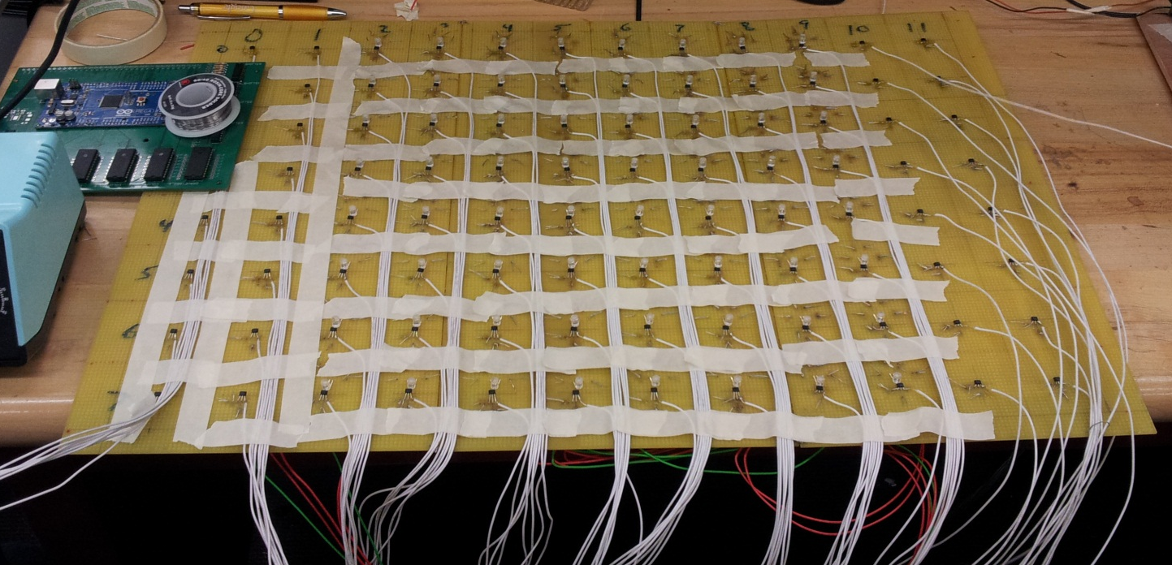
Hall-effect Grid
2D 8X12 array (96 sensors)
One sensor in the center of each tile
Powered simultaneously
6 MUXs channel output into MCU

Slide 18
Audio Module
 | Arduino-019 | rMP3 | DEV-10628
Operating voltage | 5V | 5V | 5V
Current | Unspecified | 60mA | Unspecified
Input | SPI | SPI | SPI
Outputs | 3.5mm jack, line out | 3.5mm jack | 3.5mm jack , line out
Data Storage | Micro SD up to 2GB | Micro SD up to 32GB | Micro SD
Interrupt Capable | Unspecified | Yes | Yes
Decoding Capabilities | Mp3, Ogg Vorbis | Mp3 | Mp3, Ogg Vorbis
Price | $27.50 | $64.99 | $39.95

Slide 19
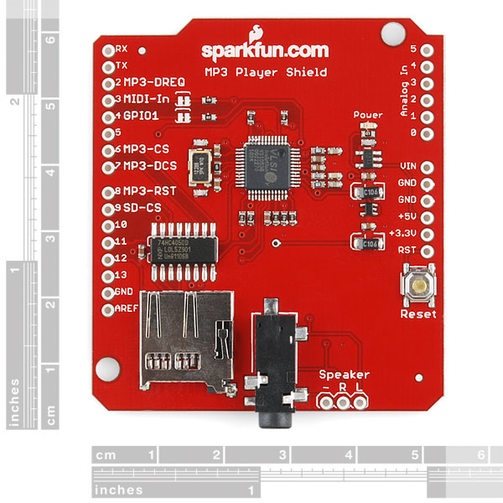
DEV-10628
Low cost audio shield
Designed for use with Arduino boards
Capable of decoding most popular audio formats
Onboard data storage
Interrupt capable through
buffer
Multiple outputs

Slide 20
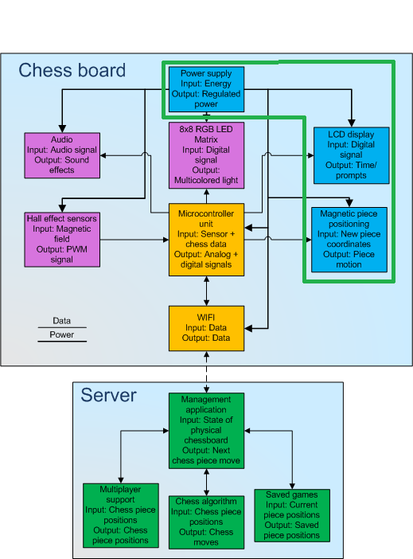

Slide 21
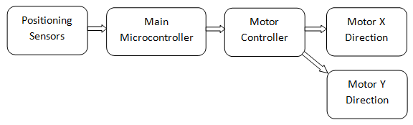
Moving System Block Diagram

Slide 22
Magnetic Piece Moving System
Main parts of the moving system are the X and Y positioning tables.
The XY rails will be located underneath the chess board
It will be capable of moving from one X-Y coordinate to another in order to move certain chess pieces

Slide 23
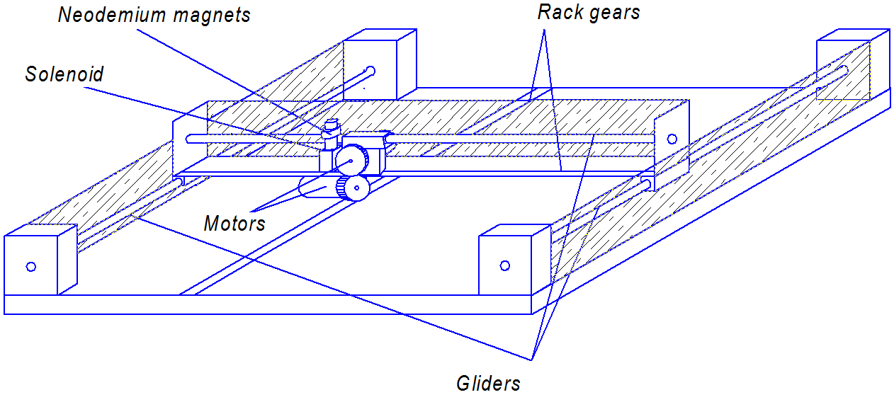
Moving system
 | Noise level | Difficulty of installation | Reliability | Cost of the system
Internal gear | High | Medium | Low | Medium
Worm gear | Low | High | High | High
Rack and gear | Medium | Low | Medium | Low

Slide 24
Magnets
Each chess piece has a magnet attached to the bottom of it
Under the board we have one strong magnet installed on the moving positioning system

Slide 25
Chess figures’ neodymium magnets
Disk 1/2” x 1/16”
N42-class
Over 6.6 lbs pulling force
Electromagnet
Model of electromagnet | R-1207-12 | EM 137 | ER2-103
Voltage, V | 12 | 12 | 24
Duty | Continuous | Continuous | Continuous
Watts | 3.3 | 5 | 4.2
Amps | 0.28 | 0.41 | n/a
Holding Force, Lbs | 45 | 33 | 22
Weight, Lbs | 0.24 | 0.24 | 0.4
Diameter, cm | 3.175 | 3.493 | 3.175
Height, cm | 1.905 | 2.06 | n/a
Price, $ | 40 | 29.24 | 76.06

Slide 26
Electromagnet & Solenoid
EM 137
  Inexpensive and lightweight
  Could not reach through the playing surface
Solenoid equipped with magnets used for replacement
Uses an electromagnet to push a rod up and down allowing the magnets to grab pieces

Slide 27
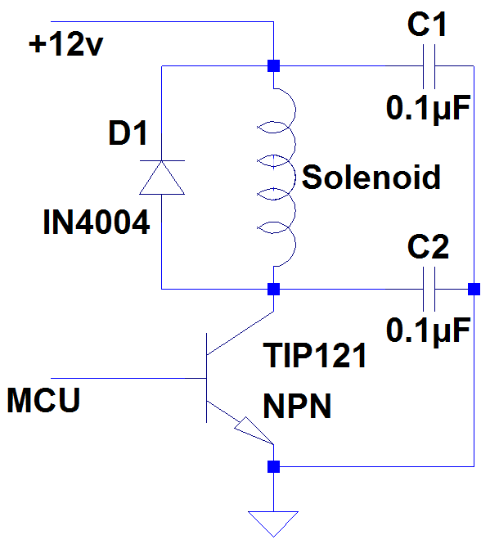
Activation Circuit Decision
We used NPN-transistor as a switch
Diode used to protect the transistor from back voltage
Capacitors reduced signal noise from solenoid.

Slide 28
Stepper motors
Motor Model # | Stepper Motor -200 steps/rev | Unipolar/Bipolar, 200 steps/rev | Applied Motion –5017–009 Bipolar Stepper Motor | Mercury ROB-09238 Bipolar Stepper Motor
Motor type | Bipolar | Unipolar/Bipolar | Unipolar/Bipolar | Bipolar
Step Angle, degree | 1.8 | 1.8 | 1.8 | 1.8
# of Wire Leads | 4 | 6 | 6 | 4
Leads length, mm | 230 | 300 | 305 | 1200
Drive Shaft Diameter, mm | 5 | 5 | 5 | 5
Rated Voltage, V | 12 | 4 | 6 | 12
Rated Current, mA | 350 | 1200 | 570 | 330
Holding Torque, oz-in | 28 | 44 | 31.4 | 31.9
Winding Resistance, Ohm | 34 | 3.3 | 15 | 34
Frame Size, mm | 42.3 x 42.3 | 42.3 x 42.3 | 42.3 x 42.3 | 42.3 x 42.3
Weights, g | 200 | 350 | n/a | 200
Price, $ | 14.00 | 19.95 | 12.95 | 14.95

Slide 29
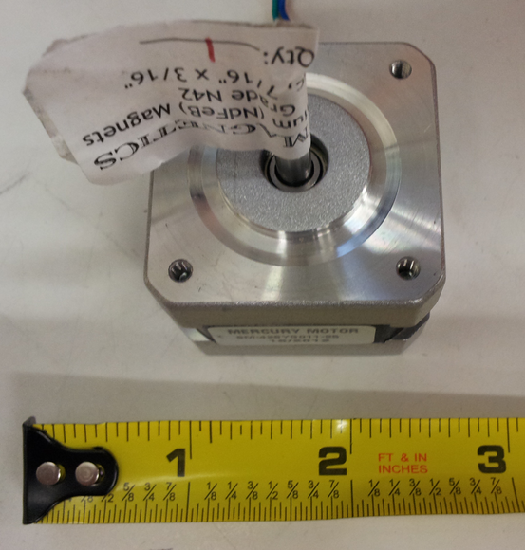
Mercury ROB-09238 Bipolar Stepper Motor
Bipolar Motor
5mm shaft diameter
12V at 330 mA
0.166 foot pounds of torque

Slide 30
Motor Driver
 | Easy Driver | Big Easy Driver | A4988 Stepper Motor Driver
Power supply range, V | From 7 to 30 | From 8 to 35 | From 8 to 35
Output power, V | 3.3/5 | 3.3/5 | 3.3/5
Microsteps | 1/2; 1/4; 1/8 | 1/2; 1/4; 1/8; 1/16 | 1/2; 1/4; 1/8; 1/16
Chip | A3967 | A4983 | A4988
Current control per phase, mA | Up to 750 | Up to 2000 | Up to 2000
Board size, in | 0.6 x 1.9 | 1.25 x 1.75 | 0.7 x 1.4
Source | Open | Open | n/a
Price, $ | 14.95 | 22.95 | 14.95

Slide 31
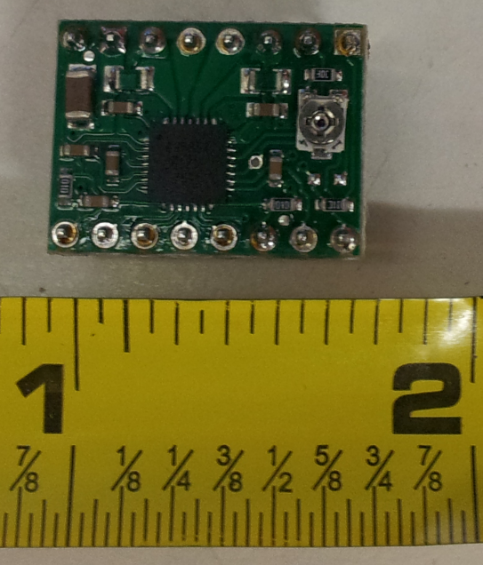
A4988 Stepper Motor Driver
8 to 35V stepper voltage range
Capable of 1/2; 1/4; 1/8; 1/16 steps
Tiny board size
Inexpensive

Slide 32


Slide 33
Microcontroller Unit (MCU)
 | PIC18F46K80 | MSP430FR5739 | Atmel Corporation ATmega 2560
Operating voltage | 1.8 - 5.5 V | 2 - 3.6 V | 2.7 - 5.5 V
Digital I/O pins | 35 | 33 | 54
Analog input pins | 11 | 14 | 16
UART & SPI busses | 3 | 3 | 4
Program memory | 64 KB | 16 KB | 256KB
Clock speed | 64 MHz | 24 MHz | 16 MHz
Experience with product | None | None | Very experienced
Price per microcontroller | $4.30 | $6.35 | $17.97
Price per development board | $165.00 | $29.00 | $58.95

Slide 34
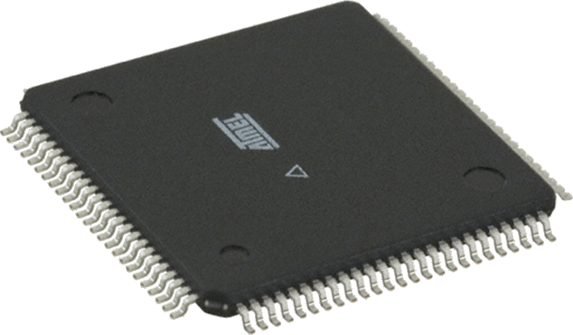
Atmel ATMega 2560
Low power 8-bit microcontroller
Clock Rate of 16MHz
4 serial I/O
Has analog to digital converter
70 General Purpose I/O
16mm

Slide 35
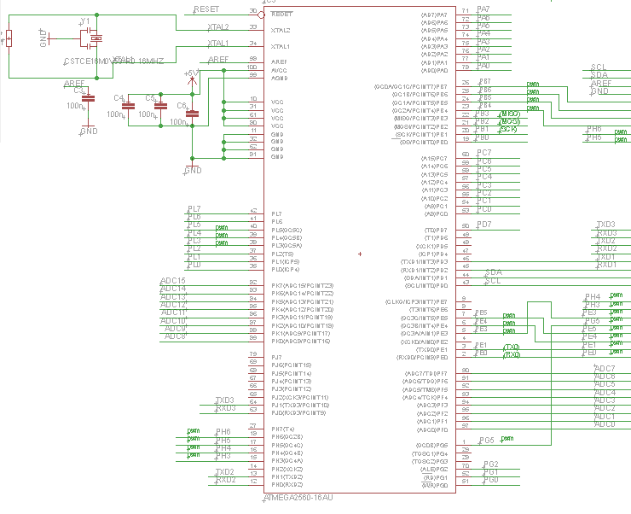

Slide 36
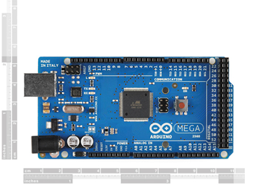
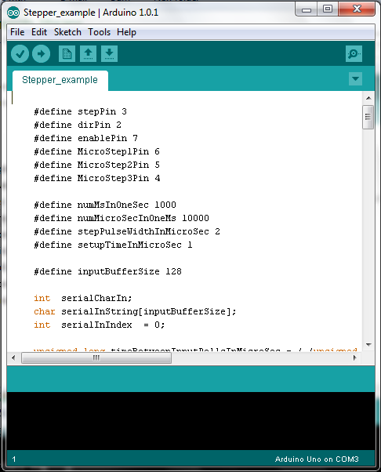
Development Environment
Hardware
  Arduino Mega 2560 R3
    Open source schematic
    Low cost
Software
  Multiplatform capability
  Community supported
  C-esque programming language

Slide 37
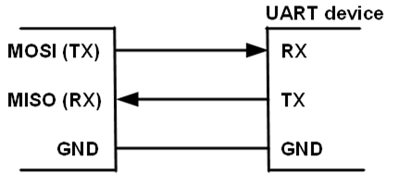
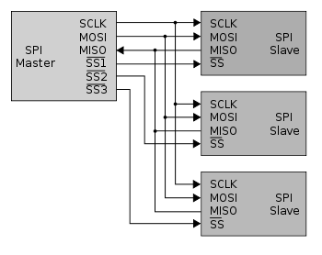
Distribution of I/O
Wireless networking
  UART bus
LCD/Stepper motors/ Solenoid/ Sensors
  General purpose I/O pins
LED
  SPI Bus

Slide 38
Wireless Networking
Device Name | WiFly GSX | XBee Series 1 | BlueSMiRf Silver
Data transfer rate | 1Mbps | 0.24Mbps | 0.1Mbps
Range | 100m | 100m | 18m
Required input voltage | 3.3V | 3.3V | 3.3V
Required input current | 210mA | 50mA | 45mA
Microcontroller interface | UART | UART | UART
Price | $84.95 | $22.95 | $39.95

Slide 39
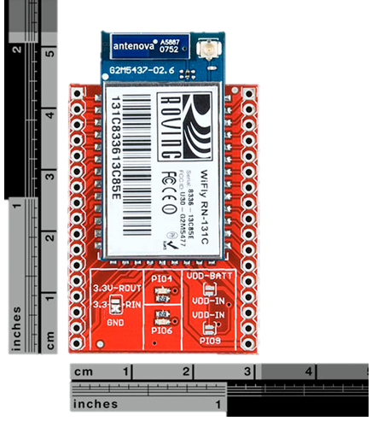
WiFly GSX
2.4GHz IEEE 802.11b/g transceiver
1Mbps data rate with TCP/IP and WPA2
Up to 100m range
UART hardware interface
WEP-128, WPA-PSK (TKIP), WPA2-PSK (AES)
FCC / CE/ ICS certified

Slide 40
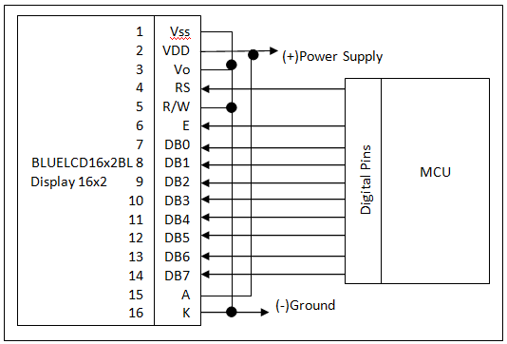
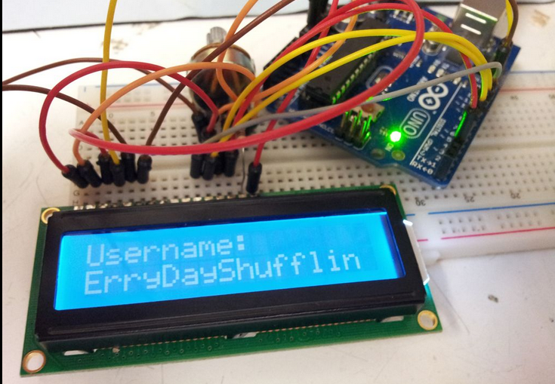
BLUELCD16x2BL LCD Display
80 mm
5V DC supply voltage
Hitachi HD 44780 display driver
Temperature range from 5 C to 40 C

Slide 41
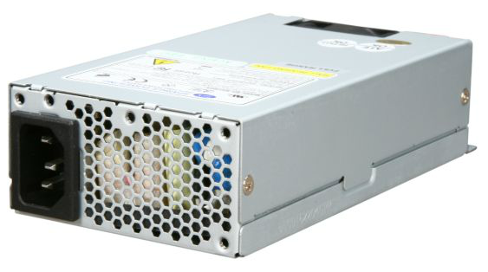
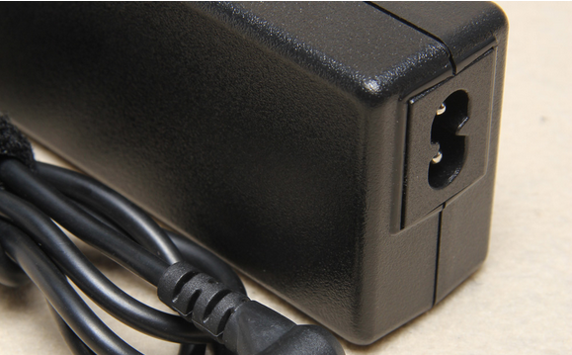
Power supply
N82E16817103064
Flex ATX /TX12VSingle/
Power150W
Output Current+3.3V@10A, +5V@13A, +12V1@10A, -12V@0.5A, +5Vsb@2A
Cost: $30
Power AC Adapter from laptop
Power 72W
Output Voltage 12 V
Output Current 6A
Cost: $10
6”
3”

Slide 42
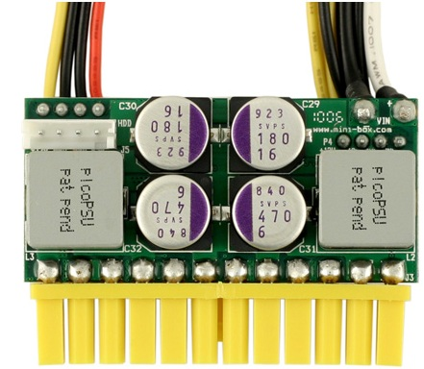
Power Supply Cont.
picoPSU-160-XT
160 Watt normal operation (200W peak)
Low component impedence 4mOhm
Supplies multiple voltage levels (12V, 5V,3V)
3”

Slide 43
Arduino Code
Wifi
  Utilize the WiFly library to connect to a secure hotspot and transmit and receive piece positions to and from the website
Sensor matrix
  Loop through the matrix of sensors and obtain the positions as they arise
Piece positioning
  Position the solenoid to the correct location
  Turn the solenoid on and travel a clear path to the new location
LED matrix
  Assign an 8 bit number to control the color of the LED
Audio
  Intended to use an interrupt and only request new data when necessary
LCD
  Utilizes the LiquidCrystal library to write to the LCD

Slide 44
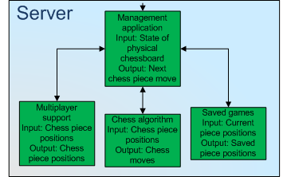

Slide 45
Management Pages
Page Name | Required Input | Optional Input | Output | Description
Log In | Username Password (SHA-1 hashed) |  | Authentication Key User ID | Logs in a user and creates a session on the server
User Info | Authentication Key User ID |  | Username LED Color Audio Theme | Get information about the currently logged in user.
Games List | Authentication Key User ID | showObserver page_count page_number | Games IDs Player usernames | Get a list of all games the user can interact with.
Game Info | Authentication Key User ID Game ID | moves move_limit | Game ID Players Board State Turn Number Active Player Turns (Optional) | Get the full state of a game, given its ID.
Create Game | Authentication Key User ID Opponent Username | allowObserver | (Success) Game ID Players Board State Turn Number Active Player | Make a new game, given a logged in user and an opponent.

Slide 46
Management Pages
Page Name | Required Input | Optional Input | Output | Description
Update Move | Authentication Key User ID Game ID Board State Move Made |  | (Success) Game ID Players Board State Turn Number Active Player | Submit a move in an ongoing game.
New Account | Username Real Name Email Address | LED Color Audio Theme | (Success) Success Code | Create a new account using the information provided.
Pass Lost | Username |  | Email containing reset key | Request a reset key for a user who has lost their password
Pass Reset | UserID Reset Key |  | (Success) Success Code | Choose a new password for the user
Add Observer | UserID Authentication Key GameID |  | (Success) Success Code | Add a user to a game as an observer.

Slide 47
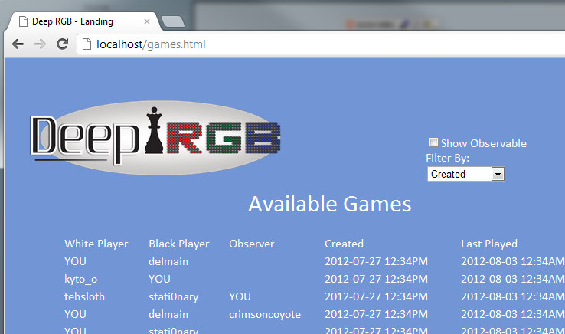

Web Interface

Slide 48
Bill of Materials
Item | Distributor | Part Num. | Quantity | Projected Cost | Total Price
PCB | 4PCB | None | 1 | $60.00 | $33.00
ATmega 2560 | Digikey | ATMEGA2560V-8AU | 1 | $30.00 | $19.97
ATmega16-U2 | Digikey | ATMEGA16U2-AU-ND | 1 | $5.00 | $3.71
Various main board components(USB socket, headers, etc) | Digikey Sparkfun Ebay | None | N/A | $50.00 | $33.46
Rover RN131C | Digikey | WRL-10050 | 1 | $40.15 | $84.95
Stepper motor driver IC | Digikey | 620-1140-2-ND | 2 | $39.90 | $27.90
Motors | Sparkfun | ROB-09238 | 2 | $29.90 | 37.68
Audio Shield | Sparkfun | DEV-10628 | 1 | $30.00 | $19.95
Racks and Gears | SDP-SI | none | N/A | $30.00 | $47.77
Neodymium Magnets | ebay | None | N/A | $4.95 | $65.25
Solenoid | Skycraft | None | 1 | $20.00 | $5.00
Hall Effect Sensors | Newark | 89T7955 | 100 | $281.43 | $135.00
RGB LEDs | Superbright LEDs | RL5-RGB-C-2 | 70 | $70.00 | $49.70
Construction Materials | None | None | None | $250.00 | $160.82
Custom PC functioning as server | Donated by team member | None | 1 | $300.00 | $0.00
Server OS | Donated by team member | None | 1 | $0.00 | $0.00
Visual Studio 10 | Donated by team member | None | 1 | $180.00 | $0.00
SQL Server Browser | Donated by team member | None | 1 | $200.00 | $0.00
Chrome Developer Toold | Google Inc. | None | 1 | $0.00 | $0.00
Total price without tax or shipping |  |  |  | $1601.03 | $745.37

Slide 49
Distribution of Labor

Slide 50
Problems
Low Hall-Effect sensor sensitivity
  Resulted in the replacement of the original sensors with the A1325
Stable power for the electromagnet
  Purchase of a third party reliable power source
SPI bus traffic
  Removal of audio
Electromagnet Impotency
  Replaced with solenoid and neodymium magnets
Wi-Fi Module not connecting
  No solution was found before presentation

Slide 51

Questions?

